Slide 1

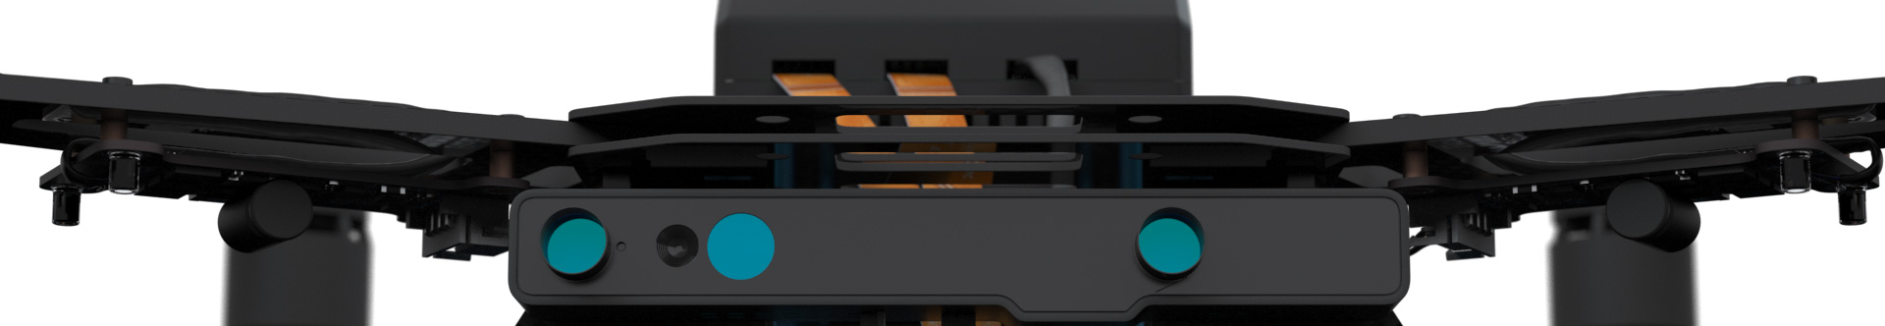
Autonomous Drone Engineer D2 – Networked Drone
Paul.Guermonprez@intel.com Autonomous Drone Solutions Architect

Slide 2
From MAVLINK Proxy to Networked Logic
In the default setup, Intel Aero is :
a Wifi access point
forwarding all MAVLINK messages to QGroundControl
But Intel Aero can do a lot more than just forward messages from a serial port on the network: we’ve seen in the D1 module how we can have local logic handling MAVLINK messages.
Let’s connect this local logic with the network!

Slide 3
Scenario
Let’s imagine the following scenario:
An IoT device is detecting an event, like a toxic gaz in a factory
The IoT device is sending the alert to the central server
The server is contacting the autonomous drone to send him on the site of the alert for further investigation
We need a way for the drone to wait and receive instructions from the network.
We’ll use WebSockets and MQTT to connect Intel Aero to the simulated servers. We’ll just arm the motors for now.

Slide 4
WebSockets

Slide 5
WebSockets?
WebSockets are typical in web applications. If you read your mail from your browser, it’s probably using a lot of it.
It is also popular in Internet of Things messaging.
WebSockets are used when you have a dialog between 1 client and 1 server (the server handling several clients) and performance or latency are not very important.
WebSockets can handle big (files) and small messages.

Slide 6
Setup
Let’s install:
The Python websocket API on Intel Aero: pip install websocket-server
A WebSocket client in your browser, to simulate a web call: https://chrome.google.com/webstore/detail/smart-websocket-client/omalebghpgejjiaoknljcfmglgbpocdp
Optionally, a Library on your development station to send the request from a script instead of your browser: pip install websocket-client

Slide 7
On Intel Aero: WebSocket Server code
A simple python code to listen for WebSocket calls:
from websocket_server import WebsocketServer import re from dronekit import connect, VehicleMode, LocationGlobalRelative import time vehicle = connect('tcp:127.0.0.1:5760', wait_ready=True) vehicle.mode = VehicleMode("GUIDED") print(‘Flight Controller Connected’)
def new_client(client, server): print("Client connected") server.send_message_to_all("Client connected") def message_received(client, server, message): if len(message) > 200: message = message[:200]+'..’ print(”Arming motors (client message: " + message+”)”) vehicle.armed = True while not vehicle.armed: time.sleep(1) time.sleep(5) print(‘Disarming’) vehicle.armed = False
server = WebsocketServer(8080, '0.0.0.0') server.set_fn_new_client(new_client) server.set_fn_message_received(message_received) server.run_forever()

Slide 8
Browser: WebSocket Client call
Start the connection (EDIT YOUR IP):
ws://192.168.1.105:8080
Click “connect”, you’ll see the server response.
Send a message, click “send”:
”Alert, Send Drone”
The motor should arm for 5s.
Your drone has local logic processing, plus network interactions using modern web technologies like WebSockets.

Slide 9
On your PC: WebSocket Client code
A simple python code to send a WebSocket client call (EDIT YOUR IP): :
from websocket import create_connection ws = create_connection("ws://192.168.1.105:8080") ws.send("Alert, send drone") result = ws.recv() print("Received '%s'" % result) ws.close()

Slide 10
MQTT

Slide 11
MQTT?
MQTT is a messaging protocol very popular in Internet of Things architectures.
A server is keeping all the messaging queues, and clients subscribe to specific messages.
MQTT is high performance, low latency. It can handle a lot of small messages efficiently.

Slide 12
Setup
Let’s install:
The Python MQTT API on Intel Aero (should be there already): pip install paho-mqtt
A MQTT client in your browser, to generate a message posting: https://chrome.google.com/webstore/detail/mqttlens/hemojaaeigabkbcookmlgmdigohjobjm?hl=en
Note: In the following code, we’ll use a public MQTT server. Please pick a unique topic name and do not overuse the public server.

Slide 13
On Intel Aero: MQTT Client code
A simple python code to subscribe to a topic from a public server, and arm motors when a message is received:
import paho.mqtt.client as mqtt from dronekit import connect, VehicleMode, LocationGlobalRelative import time
vehicle = connect('tcp:127.0.0.1:5760', wait_ready=True) vehicle.mode = VehicleMode("GUIDED") print("Flight Controller Connected")
def on_connect(client, userdata, rc): print("Client connected ") client.subscribe("aero-paul")
def on_message(client, userdata, msg): print("Arming motors ("+msg.topic+"/"+str(msg.payload)+")") vehicle.armed = True while not vehicle.armed: time.sleep(1) time.sleep(5) print("Disarming") vehicle.armed = False
client = mqtt.Client() client.on_connect = on_connect client.on_message = on_message client.connect("test.mosquitto.org", 1883, 60) client.loop_forever()

Slide 14
Browser: MQTT Post
Start the connection with the public server (mosquitto should be configured already):
test.mosquitto.org
Click “connect”, you’ll see the server response.
Pick a topic (the same as a the previous code) and click “subscribe”.
Type a message and click “send”.
Your message will be sent to the server queue for the topic, Aero being subscribed to the same topic, it will receive the message and arm the motor for 5s.
Your drone has local logic processing, plus network interactions using modern IoT technologies like MQTT.

Slide 15
Thanks
Paul.Guermonprez@intel.com

